Slide 1
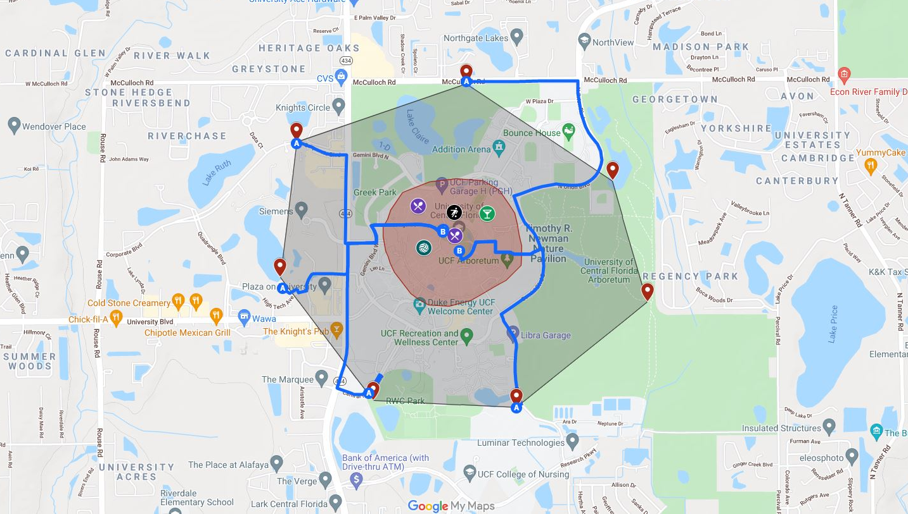

Group 20 - Large Project Presentation
Notes:
Joseph

Slide 2
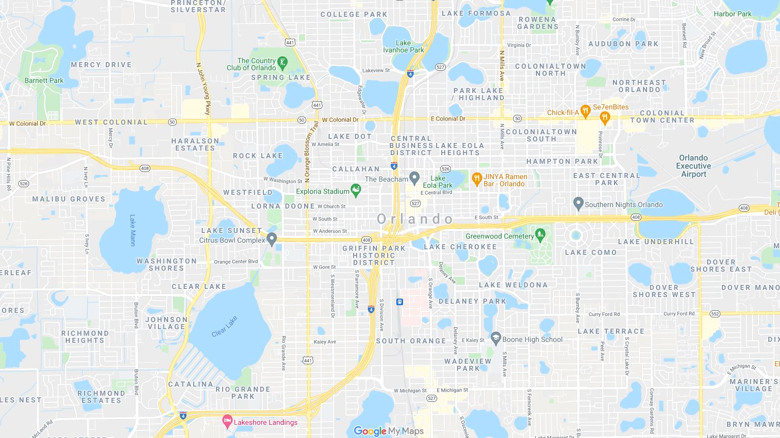











Midpoint Attractions
Nathan Kurelo Wilk
Joseph Terribile
Vijay Stroup
Kyle Olson
Midpoint Manager &
API
Frontend
Web
Mobile
GitHub Heroku
Frontend
Web
Mobile
API
& DB
Frontend
API
Jamie Henry
Wesley Ellery
Devin Besaw
Notes:
Joseph -> Nate -> Vijay -> Kyle Olson -> Jamie -> Devin -> Wes

Slide 3
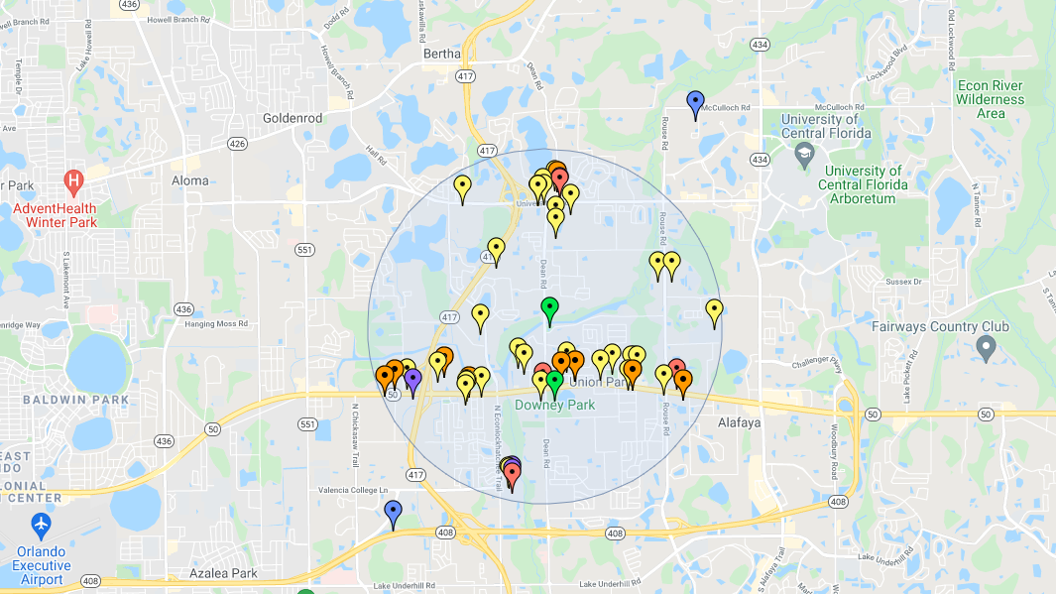
What is it
Notes:
Kyle Olson: TAKE A LOOK IN THE HOME PAGE DESCRIPTION IN ORDER TO WRITE A NICE PARAGRAPH
Midpoint is an application that we developed that takes in your location and your friends locations within a group, and displays great places to hang out in the area between the group called the Midpoint! Furthermore, you can filter out locations based on what you are specifically looking for such as restaurants, shopping, or recreational areas.
Midpoint is a social platform that allows people to form groups and share their locations to find the best places to hang out in a calculated area that we call the Midpoint!. Once the places are generated, you can filter out establishments based on your preferences of restaurants, shopping, entertainment, and recreation.

Slide 4









Midpoint Tech
Notes:
Vijay:

Slide 5


Midpoint Successes
Notes:
We are proud to announce that Midpoint was very successful overall! We have a very clean UI with location tracking of our users and an amazing algorithm to filter establishments by types & distance within the radius of the midpoint of the group. Our Authentication and CRUD functions work as expected and we are proud to say that we were able to craft a functional native app that matched our user interface and the functionality we wanted.

Slide 6
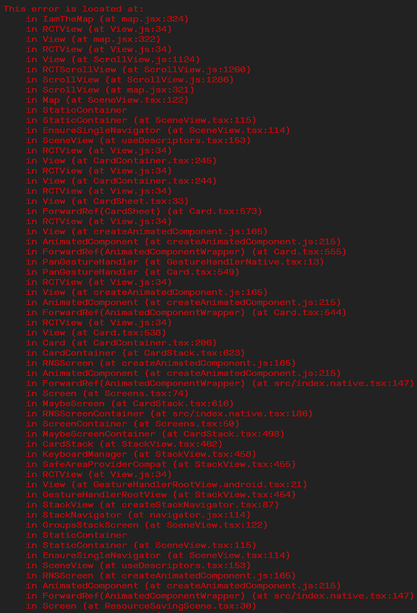
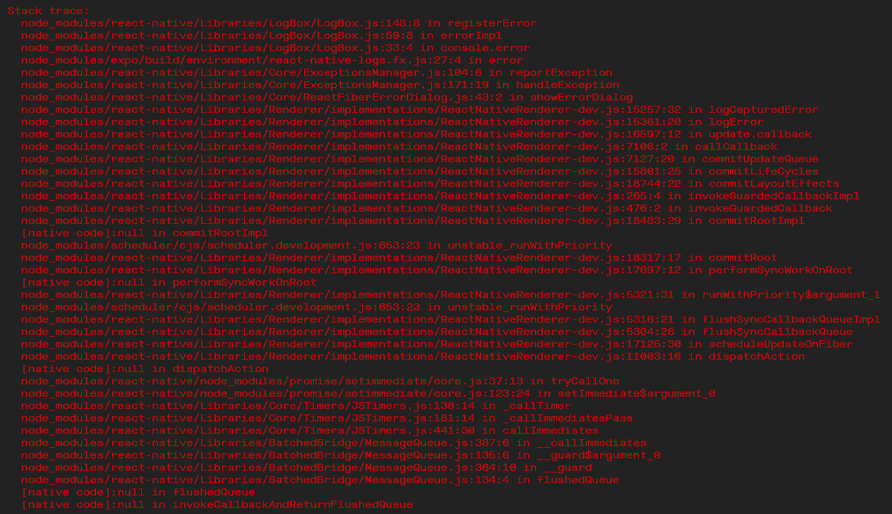
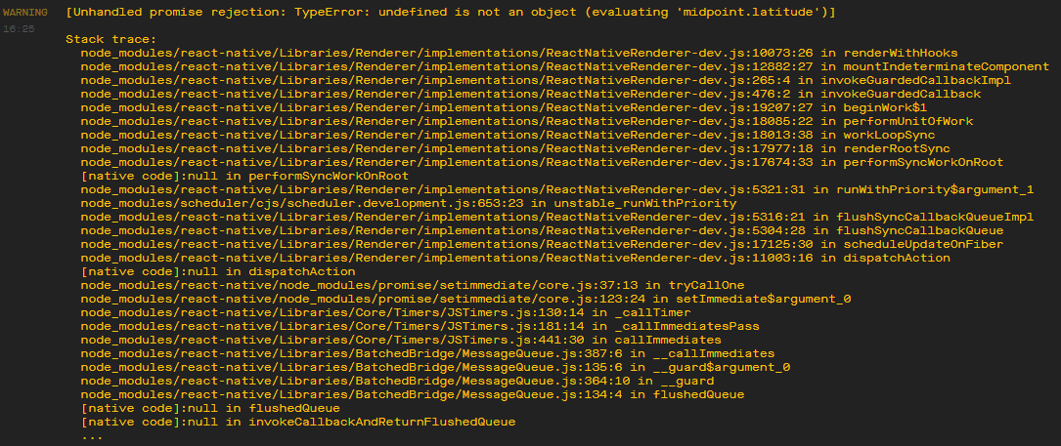
Midpoint Challenges
Notes:
Nate:
Some of the challenges that we faced while developing midpoint included how hard it was to debug the mobile app while utilizing an external device. The massive logs and stack traces would make us waste a lot of time in order to find an error. In addition to that, the variables and components props used in React and React Native were different from what we had stored in the database so it was challenging keeping track of all the variable names in different components of Midpoint.

Slide 7
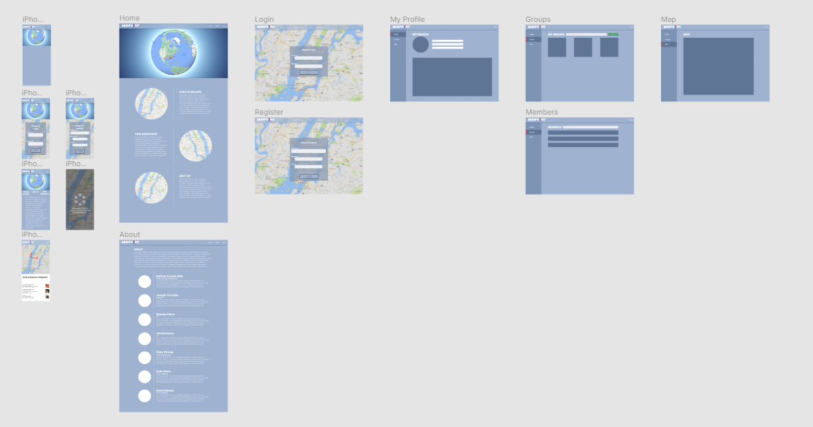
Prototypes
Notes:
Devin
Here are the prototypes for Midpoint that we developed using Figma. On the left you can see our mobile screens and in the right the web pages. Figma was extremely helpful with getting the creative juices flowing and laying out our ideas. I think prototyping is an essential step because i was able to have some direction when it came to coding and building the website instead of just staring at a blank ‘hello world’ page not knowing where to start.

Slide 8
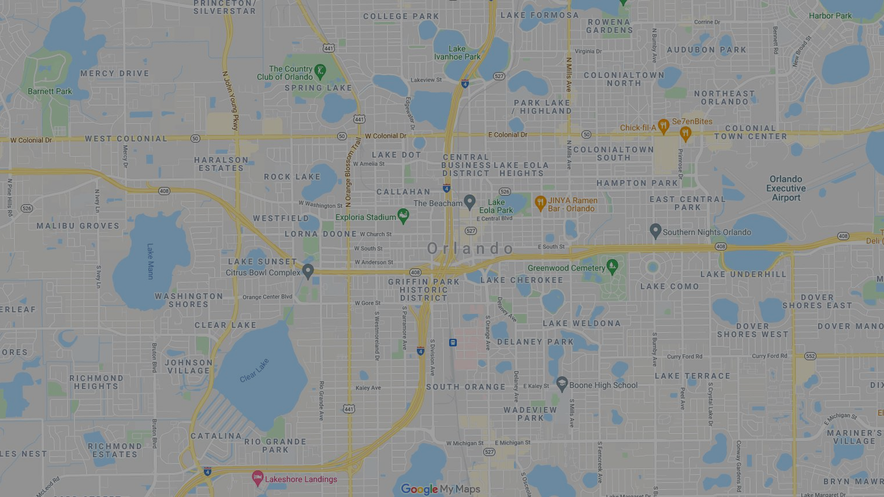
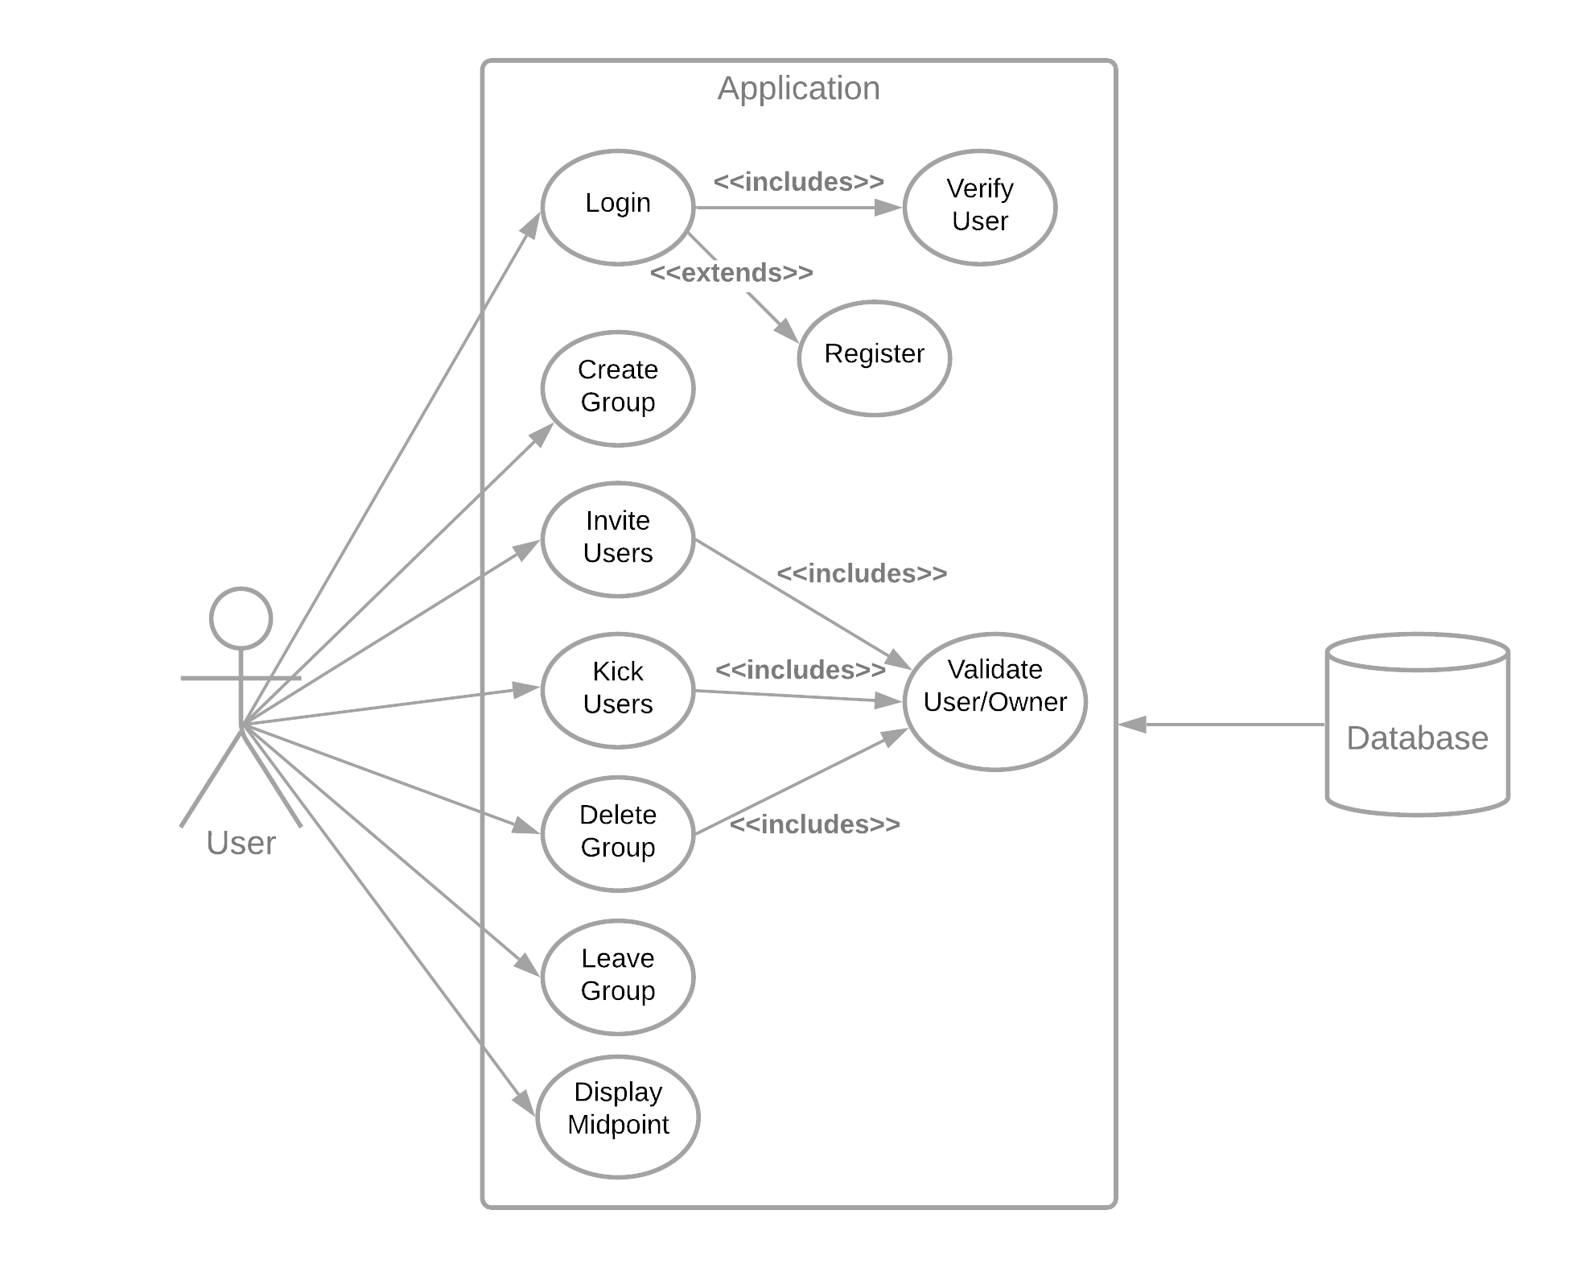
Use Case Diagram
Notes:
Wes
Here is our Use Case Diagram.
A user on our application has the ability to Login, which is checked and verified.
User Registration is also an extension to this.
A user can also Create, delete, or leave a group, and also invite and kick users.
Invite users/kick users and delete group are all validated and checked.
And the midpoint is also Displayed.

Slide 9
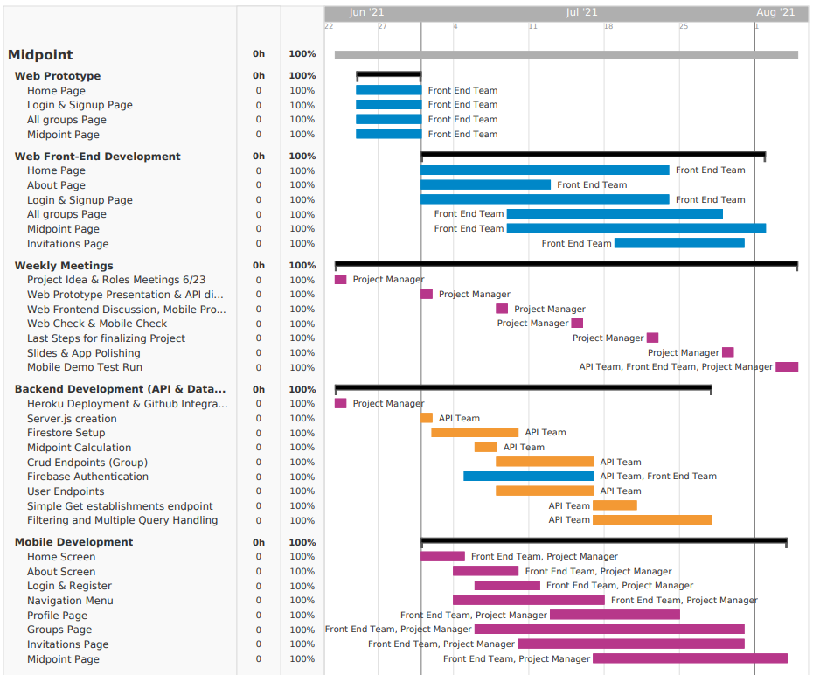
Gantt
Chart
Notes:
Wes
Here is our Gantt chart. As you can see, we started our project early getting the prototypes complete and our
Github integration/Heroku Deployment setup. We moved into working on our API and Frontend in paralell, and
communicated what additional features we wanted during our collaberation sessions. The final phases
of this project were spent on tweaking the website appreacence and getting our mobile application working.

Slide 10
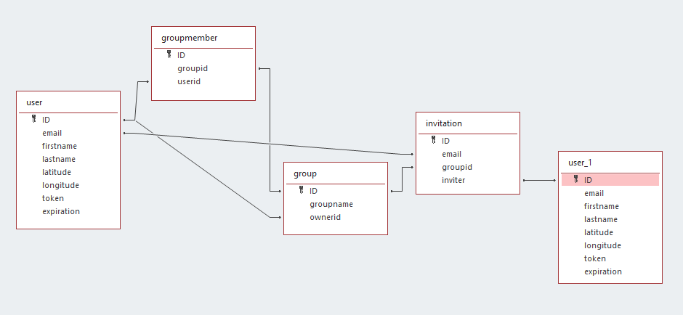
ERD
Many
Many
One
One
One
Many
Many
Many
One
One
One
Many
Notes:
Jamie
Here is our Entity Relationship Diagram. We have four collections on firestore to keep track of the users, groups, group members, and open invitations.

Slide 11
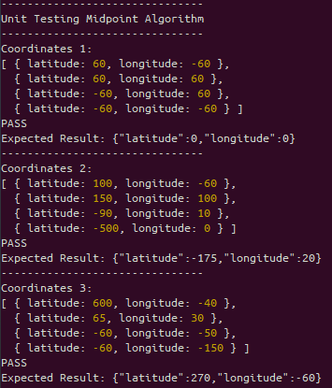
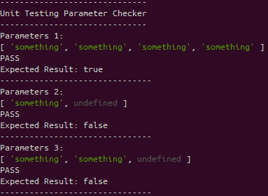
Unit Testing
Notes:
Jamie
Here are our results of the Unit testing for Midpoint. As you can see in the left, we tested the algorithm that calculates the midpoint of all coordinates in the map with the latitude and longitudes. On the right you can see that we tested a Parameter Checker for data inconsistency in our application.

Slide 12
API demo (Swaggerhub)
Notes:
Joseph:
Test /listgroups endpoint.

Slide 13

App demo (Web)
Notes:
Devin Kyle
Home Screen (Scroll Down)
Click About (Scroll Down)
Click Login
Register a demo account
Verify demo account
Hard refresh (shift + refresh)
Show profile
Logout and login to main account
Click Dashboard to show profile page (shows profile info and your current location)
Click Invitations (Show that there are no invitations)
Click Groups and create a new group
Add vijaystroup@gmail.com to group
Go back to profile and back into the map of the group to show new member
Delete temp group
Go back to groups, view web group squad
Show clicking on map markers
Show clicking on midpoint listings on right
Filter
Remove a member from group
Go back to profile and then back to web group squad to show member gone
DONT SCROLL DOWN ANYMORE
Click on map stuff
Vijay send group invite to Kyle
Show there is a new invitation and accept it
Show that the demo user was added to new group

Slide 14

App demo (Mobile)
Notes:
Main: Jamie
Backup: Kyle
Register temp account midpointtest53@gmail.com
Logout
Login to main
Talk about home page
Talk about about page
Go to profile
Show off profile page with location
Go to groups
Refresh groups
Create new temp group
Go to temp group
Invite vijaystroup@gmail.com
Vijay accept
Go out and come back into temp group
Kick vijay
Leave temp group
Click on mobile squad group
Show off map, click on markers
Vijay send two invitations
Go to invitations
Refresh
Accept and decline groups
Go back to groups and refresh

Slide 15
Questions
Notes:
Vijay or Joseph

